Slide 1
Climate Change Presentation
Myles Biss

Slide 2
Agenda
Raw Data
EDA Process
Data Cleaning
Interactive Dashboard
Drawing Conclusions
Thank You!
Citations

Slide 3
Raw Data Source
https://climateactiontracker.org/
Sourced Data from UN
Downloaded Raw Dataset
https://www.naturalearthdata.com/downloads/10m-cultural-vectors/
Admin 0 – Countries
https://climate.nasa.gov/vital-signs/global-temperature/?intent=121
Global Temperature Average from Nasa

Slide 4
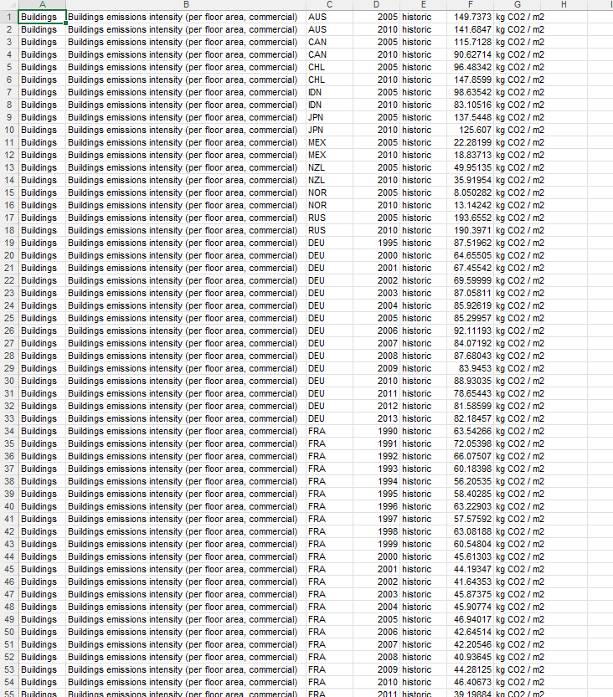
Raw Data

Slide 5
How Data Works
Emissions intensity of electricity generation | gCO2/KWH
World | 9636.82
2000 | 584.87
2001 | 586.34
2002 | 589.74
2003 | 602.79
2004 | 597.47
2005 | 602.05
2006 | 605.62
2007 | 614.45
2008 | 607.56
2009 | 603.76
2010 | 604.46
2011 | 611.9
2012 | 610.06
2013 | 611.69
2014 | 608.32
2015 | 595.74
Grand Total | 9636.82
Only Electricity data will be analyzed
All values from the dataset are ratios
World is just an average
Example is World Data only

Slide 6
EDA Process
Explanation in Jupyter Notebook

Slide 7
What is Climate Change?
Climate change is a long-term shift in global temperatures and weather patterns
Human behavior is the main driving force behind climate change
The shift in global temperature increases started in the 1800s during the dawn of the industrial revolution
Which is when humans began to use fossil fuels
Such as Coal

Slide 8
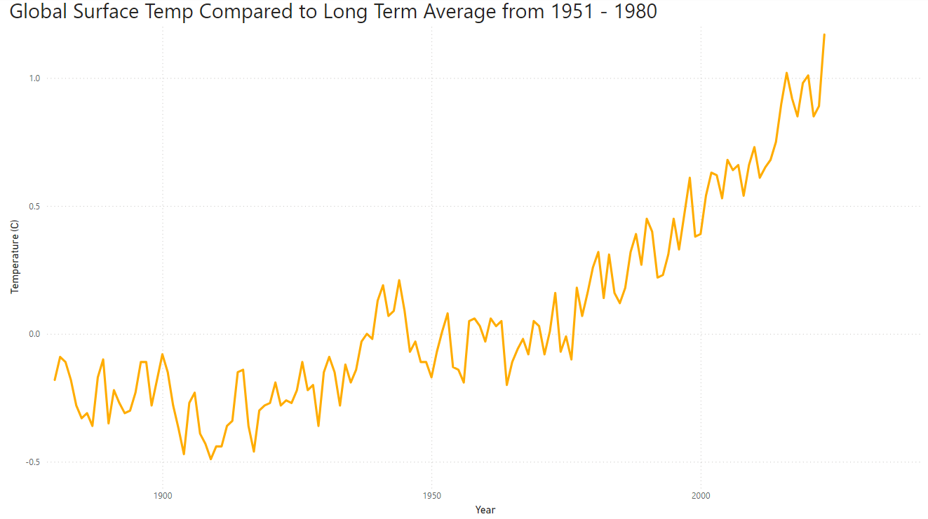
Global Temperature Increases

Slide 9
PowerBI

Slide 10
Conclusions
Climate Change is a Global Problem
Coal power should be phased out
Third and Second World countries use lots of Coal
Coal power plants are cheap
They have more pressing matters
Best we can hope for is countries like China, India, and Australia to start reducing their Coal powerplant usage in favor of another power option
Like Nuclear, Hydro, or Solar

Slide 11
Sources

